Slide 1

Angular Directives

Slide 2
What is Angular Directive?
In Angular, Directives are defined as classes that can add new behaviour to the elements in the template or modify existing behaviour.
The purpose of Directives in Angular is to maneuver the DOM, be it by adding new elements to DOM or removing elements and even changing the appearance of the DOM elements.
Directives are meant to be a function that executes when found in the DOM by the Angular compiler to extend the power of the HTML with new syntax

Slide 3
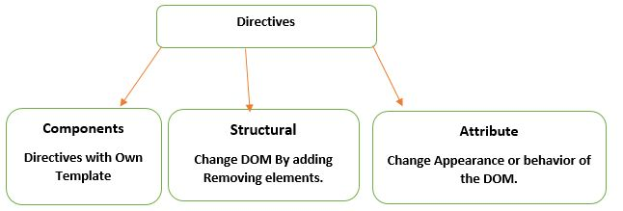
Types of Directives in Angular
*ngFor
*ngSwitch
*ngIf
*ngClass
*ngStyle
*ngModel

Slide 4
Creating a custom directive
>ng g directive <directive name>

Slide 5
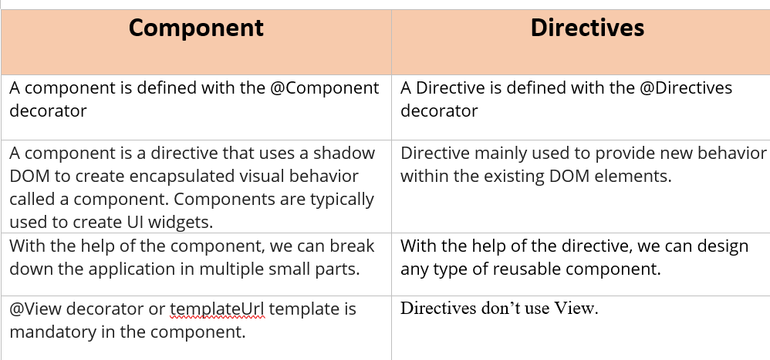
Component Vs Directive

Slide 6
